Slide 1
Help International Aid Allocation
Name: VIKUL AGGARWAL

Slide 2
Background
Mission of Help International: To fight poverty and provide the people of backward countries with basic amenities and relief during the time of disasters and natural calamities.
Task at hand: To categorize the given countries using socio-economic and health factors that determine the overall development of the countries. This categorization is then to be used to suggest the countries which are in direst need of aid. These suggestions will be used for strategic and efficient spending of the around $10 Million that have been raised.
Business objective: To identify the countries that are in the direst need of aid so that funds can be allocated for welfare.
Process used for the problem statement: Principal Component Analysis and Clustering.

Slide 3
DATA UNDERSTANDING
Types of variables:
Variables related to economic state of a country
Variables related to health factors
Socio-Economic Indicators | Health Factors
GDP per Capita | Child Mortality Rate
Income | Life Expectancy
Inflation | Total Fertility
Exports | Health Spending
Imports

Slide 4
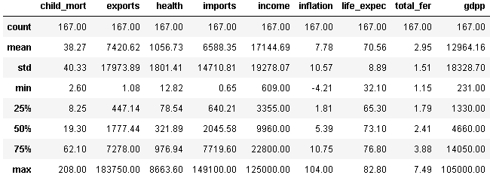
Spread of the Data

Slide 5
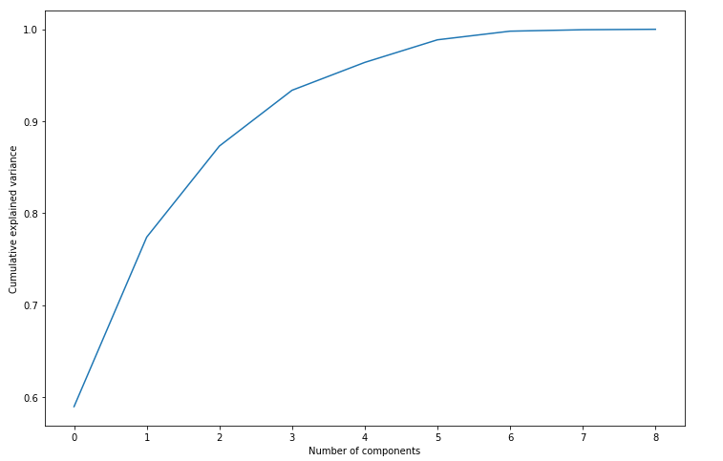
Cumulative Explained Variation vs No of PCs
4 Principal Components are enough to explain ~95% of variance in the data.

Slide 6
Hopkins Statistic
The Hopkin’s Statistic for PC Modified data was found to be more than 0.9 showing a high clustering tendency.

Slide 7
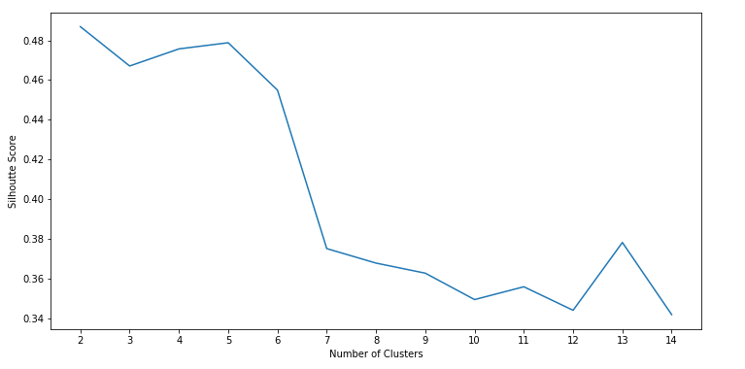
Silhouette Analysis for K-Means Clustering
Silhouette score is high for k between 2 to 5, and then drops drastically beyond 5.

Slide 8
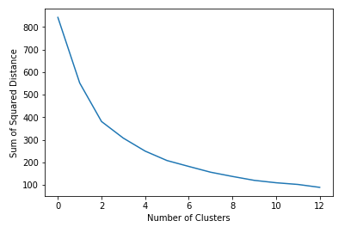
Elbow Curve Analysis
Points 2 to 5 look like the elbow of the curve, i.e. the appropriate number of clusters that can be taken.

Slide 9
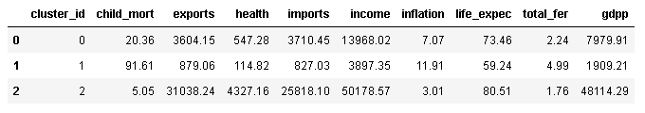
K-Means with K=3
Following are the number of countries in each cluster when K-Means is performed with K=3:
Cluster 0 – 91
Cluster 1 – 48
Cluster 2 – 28
Following are the cluster-wise mean values for the features:
It is evident from the above values that the cluster representation is as follows:
Developed - Cluster 2 (High values for GDPP, Income, Life Expectancy; Very low values for child mortality etc. )
Developing - Cluster 0 (Moderate values for GDPP, Income, Life Expectancy, child mortality etc.)
Under-Developed - Cluster 1 (Low values for GDPP, Income, Life Expectancy; high values for child mortality etc.)

Slide 10
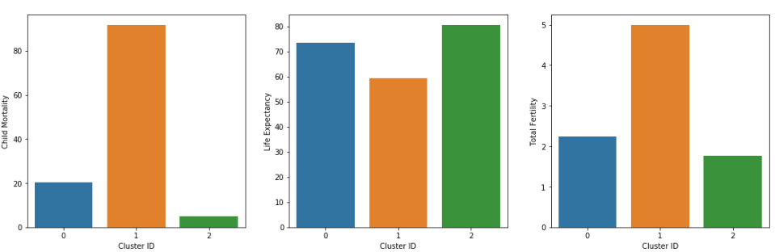
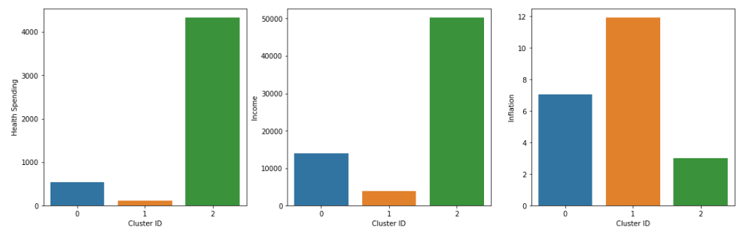
Cluster-wise mean values - Plots

Slide 11
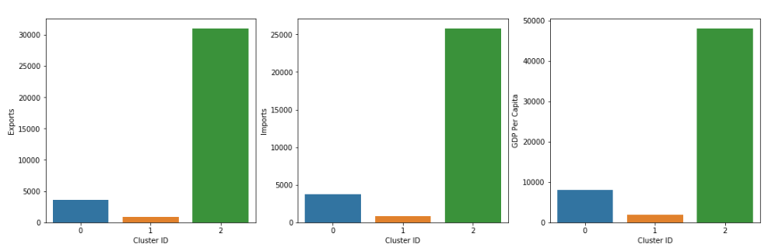
Cluster-wise mean values – Plots (Contd..)
Looking at the cluster-wise mean values, it is evident that the countries in cluster with cluster ID 1 need to be analyzed to find out the countries in direst need of aid.

Slide 12
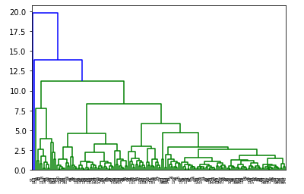
Hierarchical Clustering – The Dendogram

Slide 13
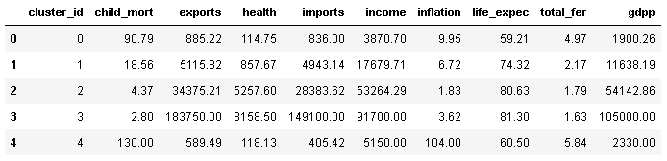
Cluster-wise mean values for features after Hierarchical Clustering
Following are the cluster-wise mean values for the features after using n_clusters = 5:
Looking at the cluster-wise mean values, it is evident that the countries in cluster with cluster ID 0 and 4 need to be analyzed to find out the countries in direst need of aid.

Slide 14
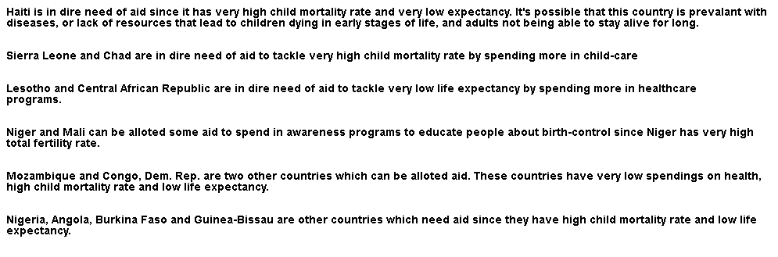
Countries in dire need of aid
Following are the countries in dire need of aid. Chosen clusters were analyzed and countries with child mortality more than the 95th percentile, life expectancy less than the 5th percentile, health spending less than the 5th percentile and total fertility more than the 95th percentile were picked.

